Slide 1

Who are we?
We are the Parent Teacher Friends Association (PTFA) for Hasland Infant School. We are a Friends Group which means everyone can become involved, whether you are a parent, guardian, teacher, aunt, uncle, grandparent, the list goes on. Starting school is an exciting time for the whole family.
Friends of Hasland Infant School
Registered Charity Number 1161115

Slide 2
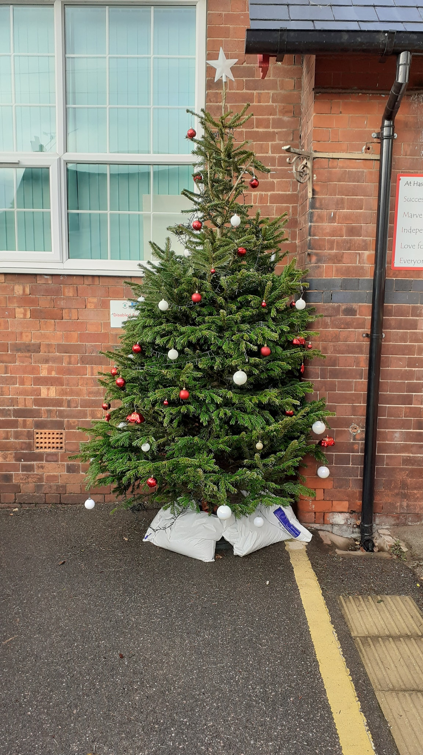
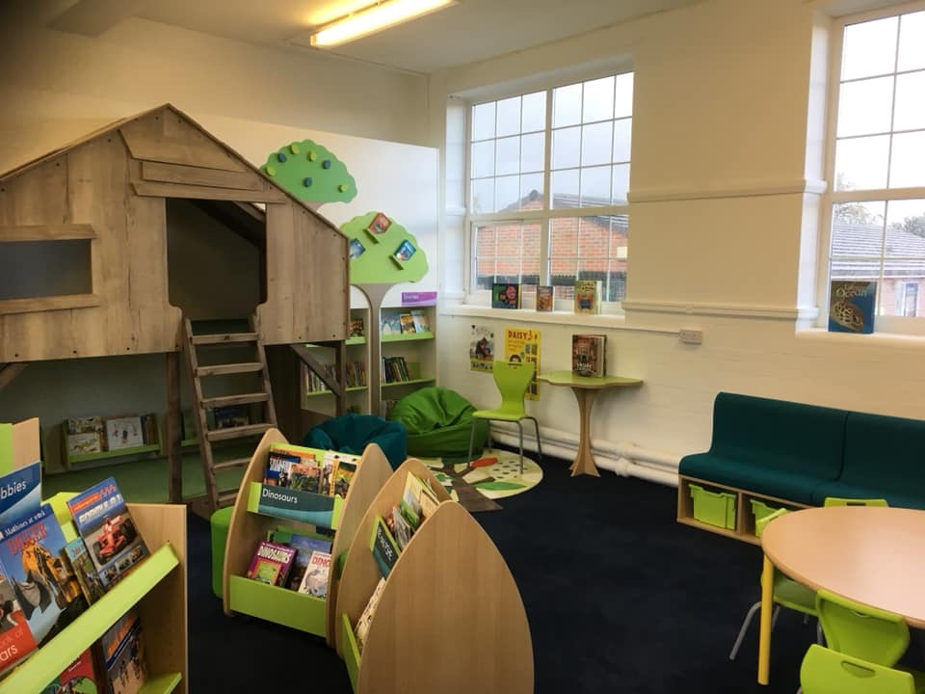
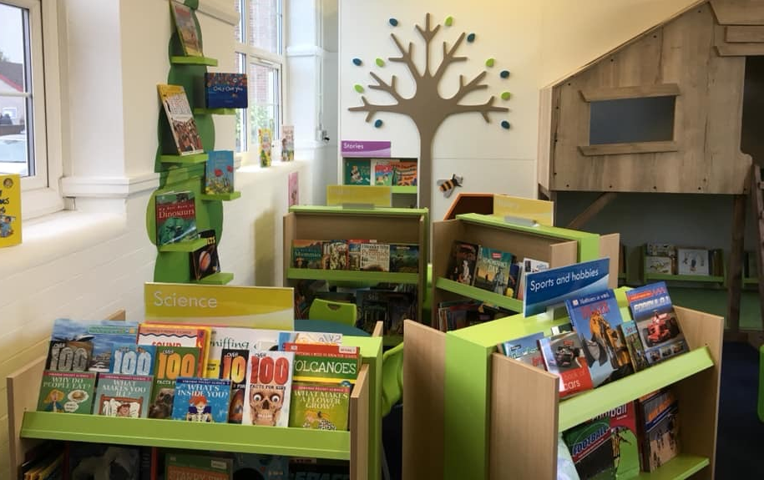
What do we do?
We organise lots of events through the school year and raise money for equipment and resources to enhance the children’s experience at school.
We have recently funded new Christmas decorations for the school, some new friendship benches and technology resources to be used throughout school. We have previously raised £15,000 for the refurbishment of the school library.

Slide 3
Our Events
We try to run many different events throughout the school year.
Christmas Shop
Christmas Fair
Summer Fair
Discos
PTFA Meetings
Christmas Cards
Bag 2 School
Film Nights
Fashion Shows

Slide 4

Why get involved?
Not only do we get a huge satisfaction from organising fun events for the children and their families, and raising money for extras that the school budget cannot accommodate, being on the PTFA is also a great way to get to know other parents and become part of the school community.

Slide 5
How can you get involved?
There are lots of ways you can help and support us at our events. However, not all of these jobs need to happen in school. We really couldn’t achieve what we do without the help we receive behind the scenes.
Folding tickets for the raffle
and tombolas.
Setting up events.
Helping at the discos.
Offering any help and support you feel you are able to!
Wrapping books for Santa.
Shopping for prizes.
Running stalls with
other parents at our Summer and Christmas Fairs.
Researching new, fun
activities.
Helping at the
Christmas Shop.

Slide 6
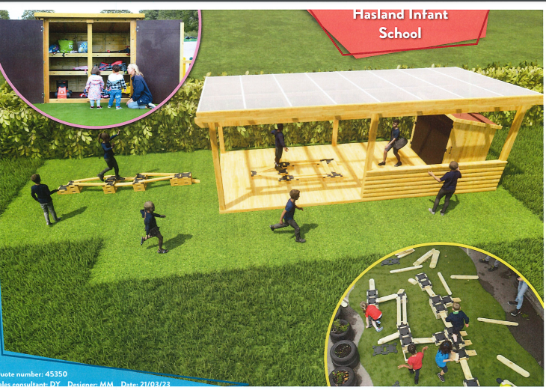
What are we raising money for?
Creativity and imaginative play is an integral part of this school’s curriculum. Next year we will be raising money to help them create an exciting new area in the outdoor environment which will allow all the children to develop and stretch their imaginations even further.
The aim is to provide the children with a range of easily accessible loose parts so that they can work with their friends, share ideas and problem solve to create and build interesting new structures whilst at the same time having a great deal of fun and enjoyment. This new area will be called “The Innovation Station.”

Slide 8

In September we lose a large part of our PTFA. Without new volunteers we
may not be able to continue.
We are looking for people who would like to join our fantastic team.
There are lots of opportunities to help and there is no obligation to attend
every meeting or event!

Slide 9



July Events
Summer Fair : Wednesday 21st June, 3:20pm, school playground
You are invited along to join us all for our Summer Fair. We will be holding a big raffle and there will be lots of fun and games for the children to do.
AGM : Wednesday 19th July, 9am in school
This is our annual AGM and celebration of our efforts for this school year. Everyone is welcome to attend and find out more about what we have been doing. There will be cake!
September Events
PTFA Meeting : TBA
In September we will be holding our first meeting of the school year. Our meetings are friendly and informal and we would love you to come along and find out more about what we do. This year we are hoping to hold our first meeting in the Community Hub in Hasland.

