Slide 1
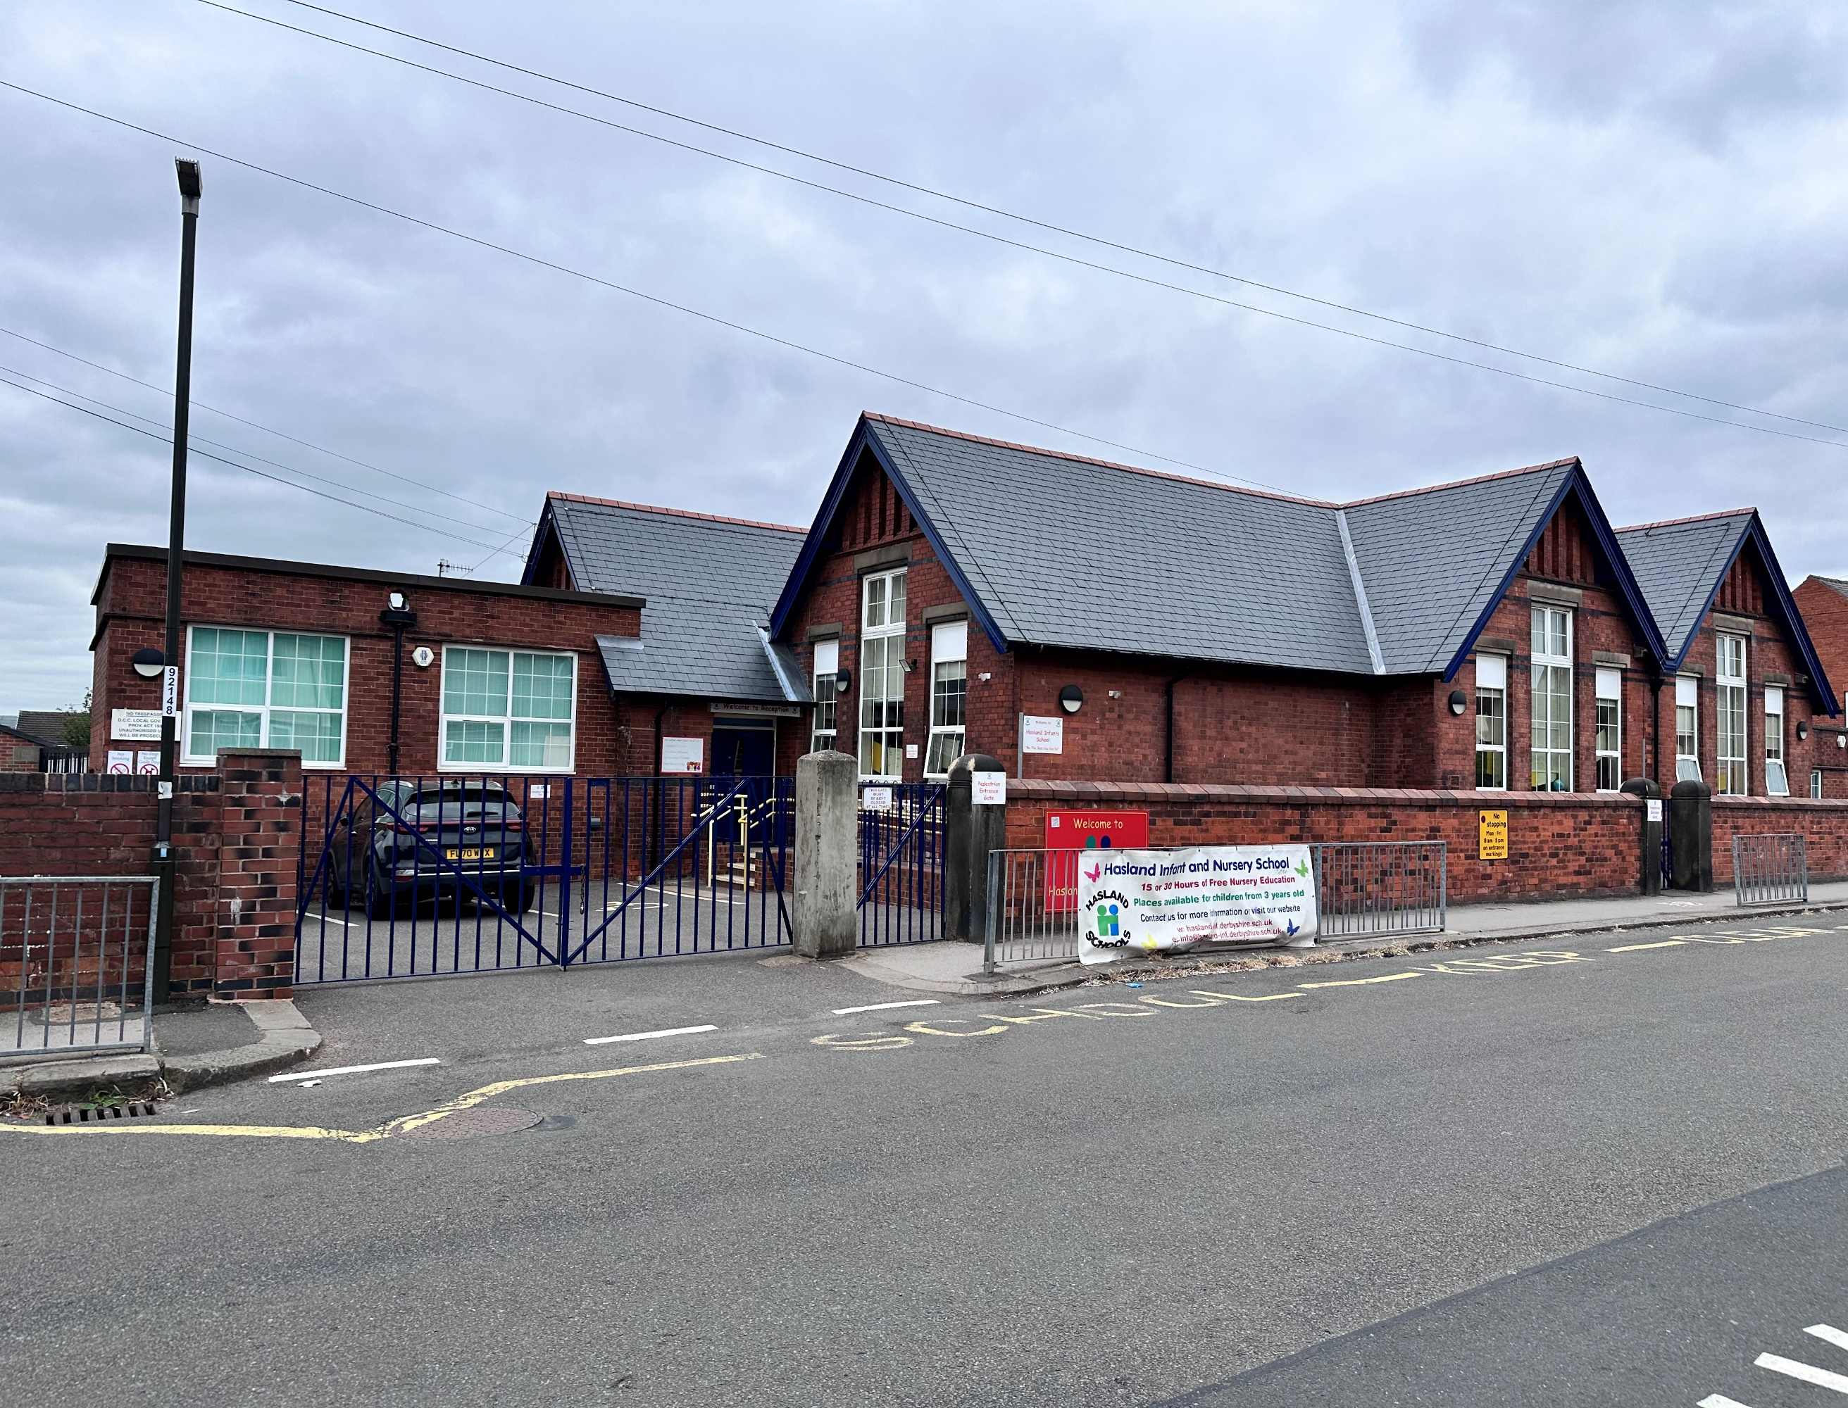
Hasland Infant School
Reception
New Parents Meeting
September 2024

Slide 2
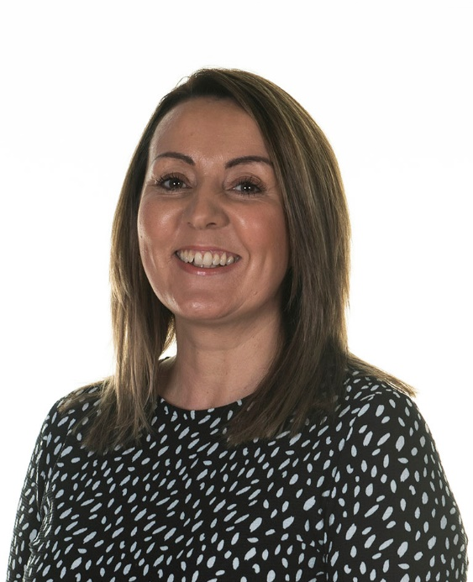
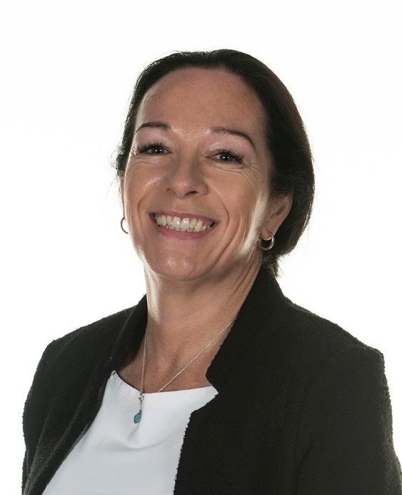
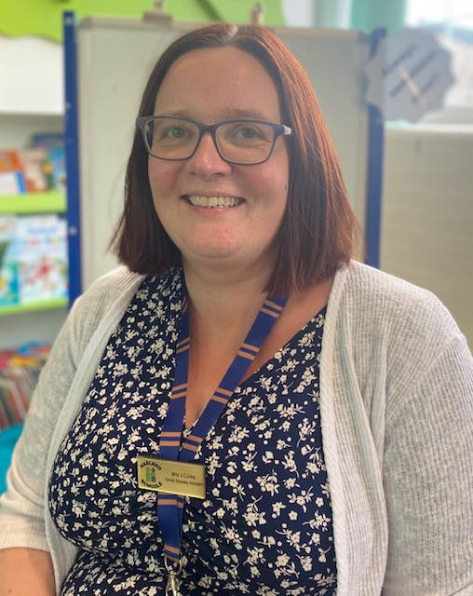
WELCOME
Mrs A Daykin
School Business Manager
Mrs C Fern Mrs J Coles
Senior Business Assistant School Business Assistant

Slide 3
communication
How we communication with you:
ParentHub – Newsletters and weekly communications from the school office and your class teacher
Website – www.hasland-inf.derbyshire.sch.uk – Please visit our website where you will find lots of information such as school Policies, dates for the school year and curriculum information.
How you can communicate with us:
You can contact the school office by visiting our reception between 8am and 4pm each day or by telephone – 01246 234745
You can also email school – info@hasland-inf.derbyshire.sch.uk
During drop off and collection times your child’s class teacher or teaching assistant will be available on the door for you to speak to.
If your child is poorly please contact the school office by 9am and state the reason for the absence.

Slide 4
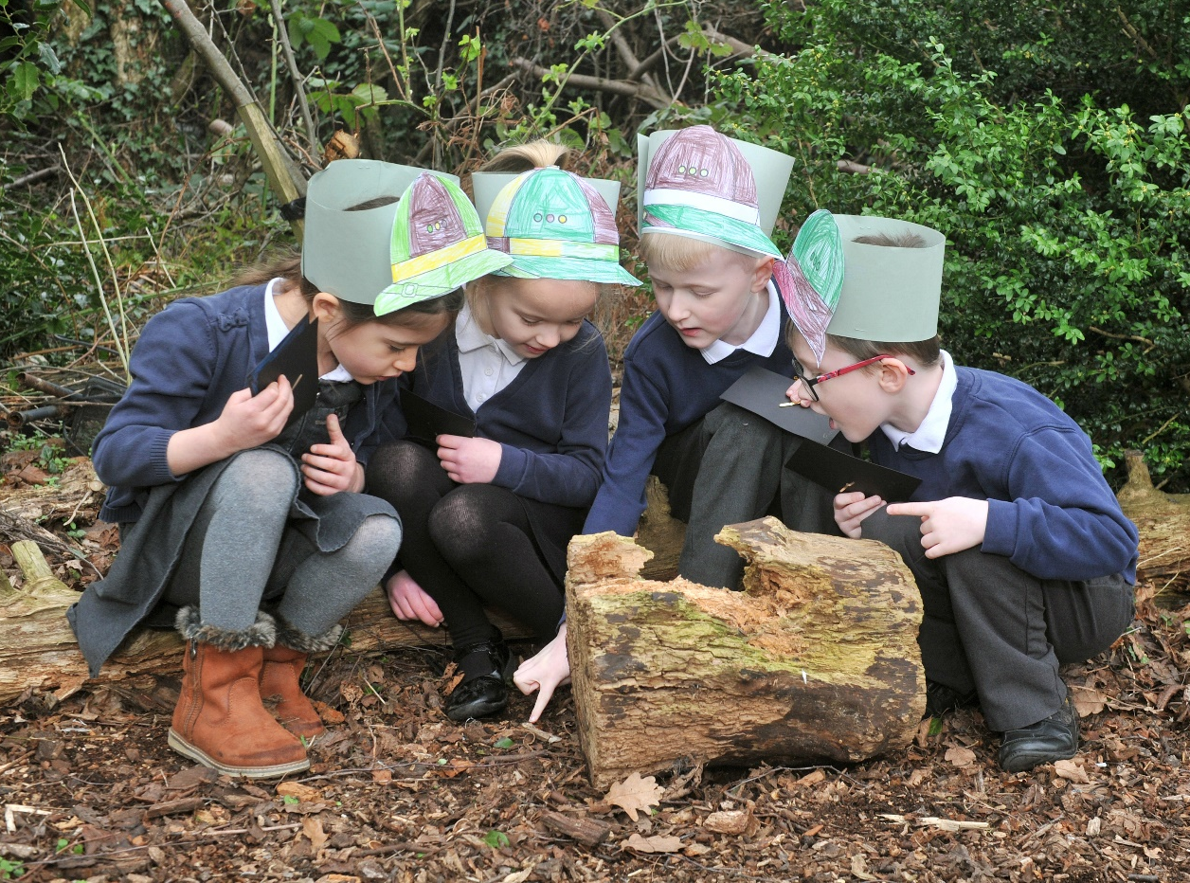
PARENT pAY
Each year your child will have the opportunity to go on a school trip. In Year 2 they will also have the opportunity to attend a 2 day residential!
Our school operates a cashless system and all payments are made via Parent Pay.
The following items can be paid
via Parent Pay.
Trips & visits
Library Bags
PTFA events

Slide 5

SCHOOL UNIFORM
.
Grey trousers/skirt or dress.
White polo shirt
Navy jumper or cardigan
Sensible shoes for outdoor
learning
Waterproof coat
More information regarding our uniform can be found on our school website.
Uniform with our school logo can be ordered from our supplier via the school website or you can purchase uniform from your local supermarket.
ii

Slide 6
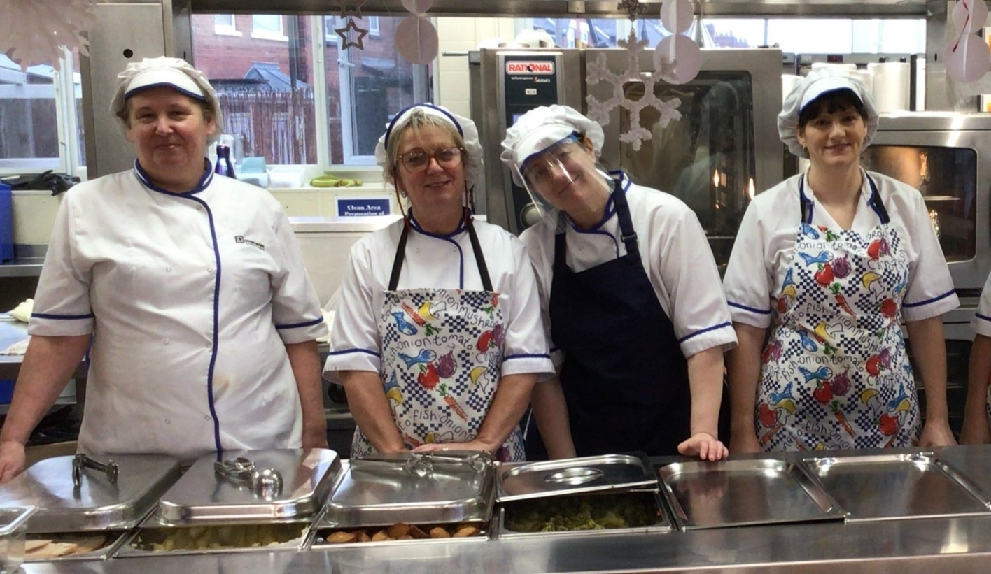
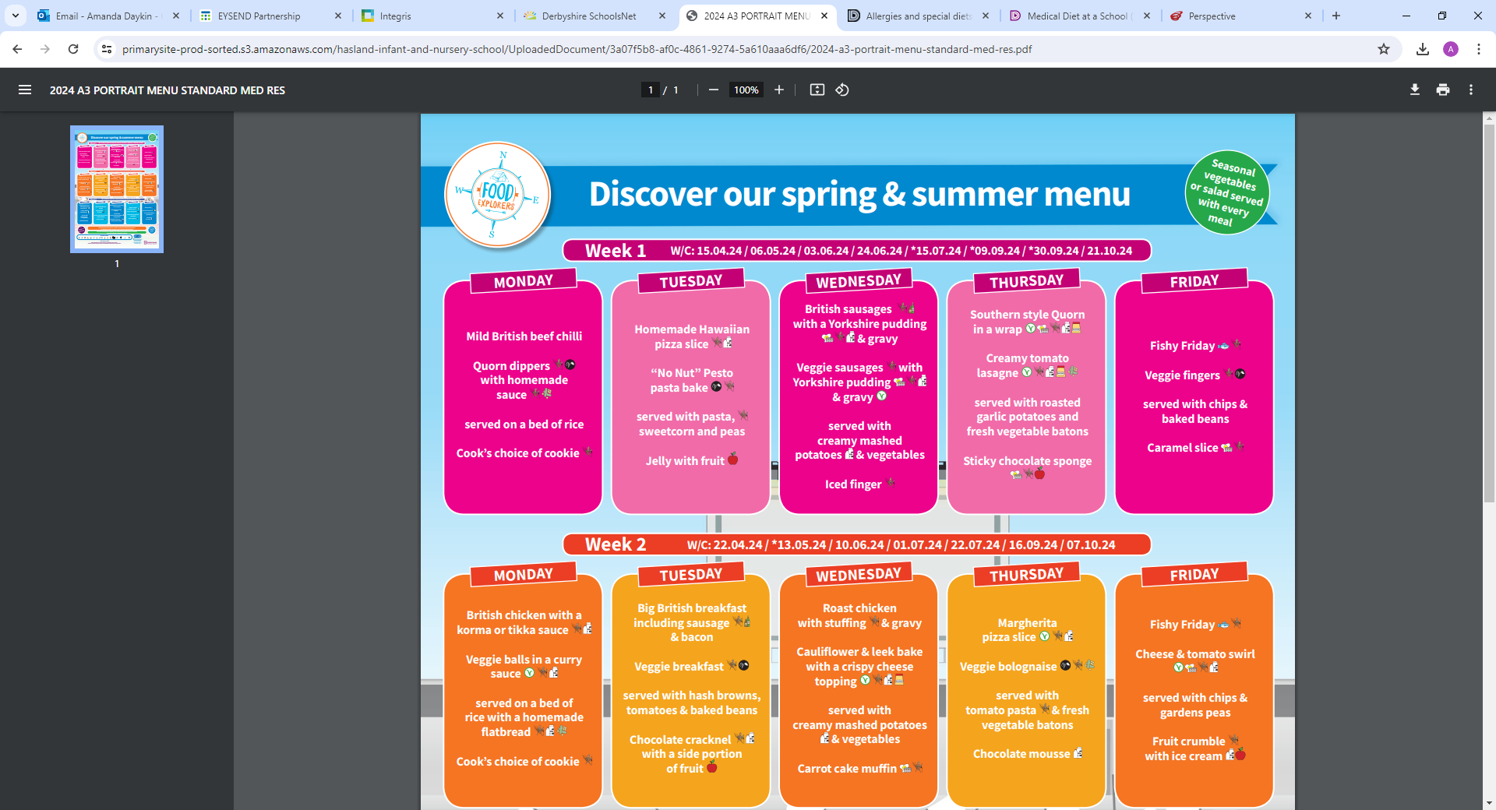
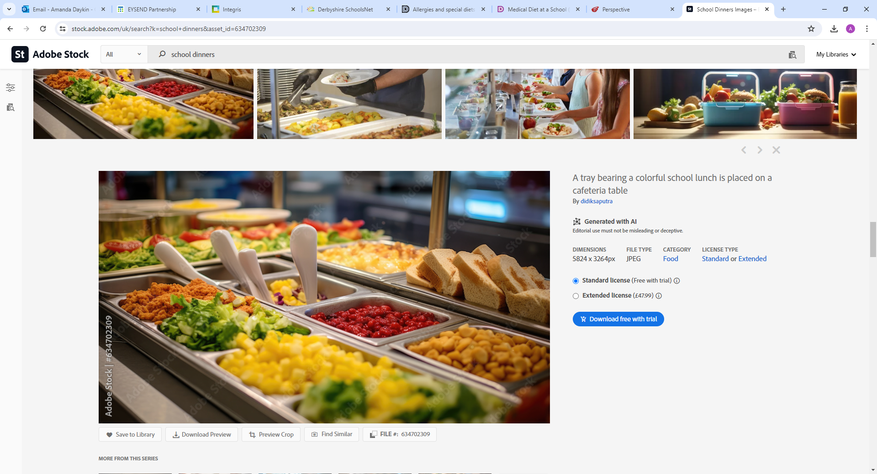
School Meals
Universal Free School meals
Pupil Premium funding
Medical Diet
Nut Free school

Slide 7

What happens if my child is ill or has an accident at SCHOOL?
First Aid administered
Head bump message through Parent Hub
Child monitored
Prescription medicines only
Paracetamol
Parental permission
If your child suffers from sickness or diarrhoea they will not be able to attend school until 48 hours since the last bout.

Slide 8
Junior Saves Scheme
We are delighted to introduce the Junior Saving scheme whereby children can open an account and start saving/managing their pocket money.
On opening an account, children will be given a Junior Savers Passbook which they will bring with them on a Thursday morning when they want to deposit or withdraw money.
The School Bank will be open every Thursday morning between 8.15am and 8.45am starting from 12th September.
This is a fantastic way to give your child some ownership of their pocket money, and to encourage them to save for treats that they may want.

Slide 9
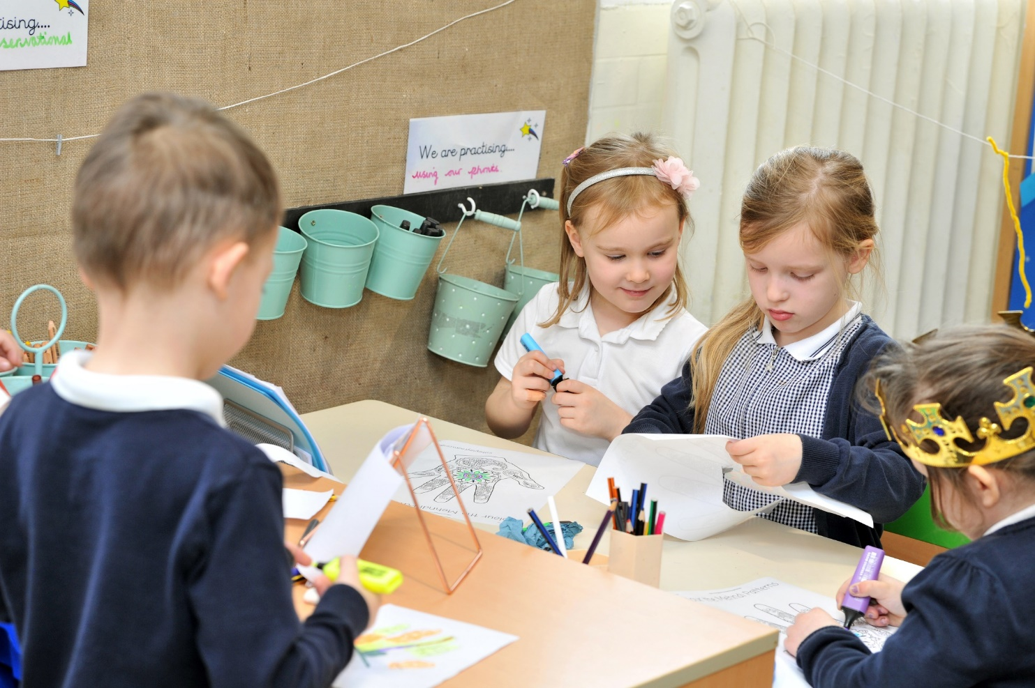
Parent packs
In your pack you will find lots of useful information such as:
How to download ParentHub onto your phone.
School term dates
Policies
Please return your completed
forms to school along with a
copy of your child’s
birth certificate on
Wednesday 3rd July.

Slide 10


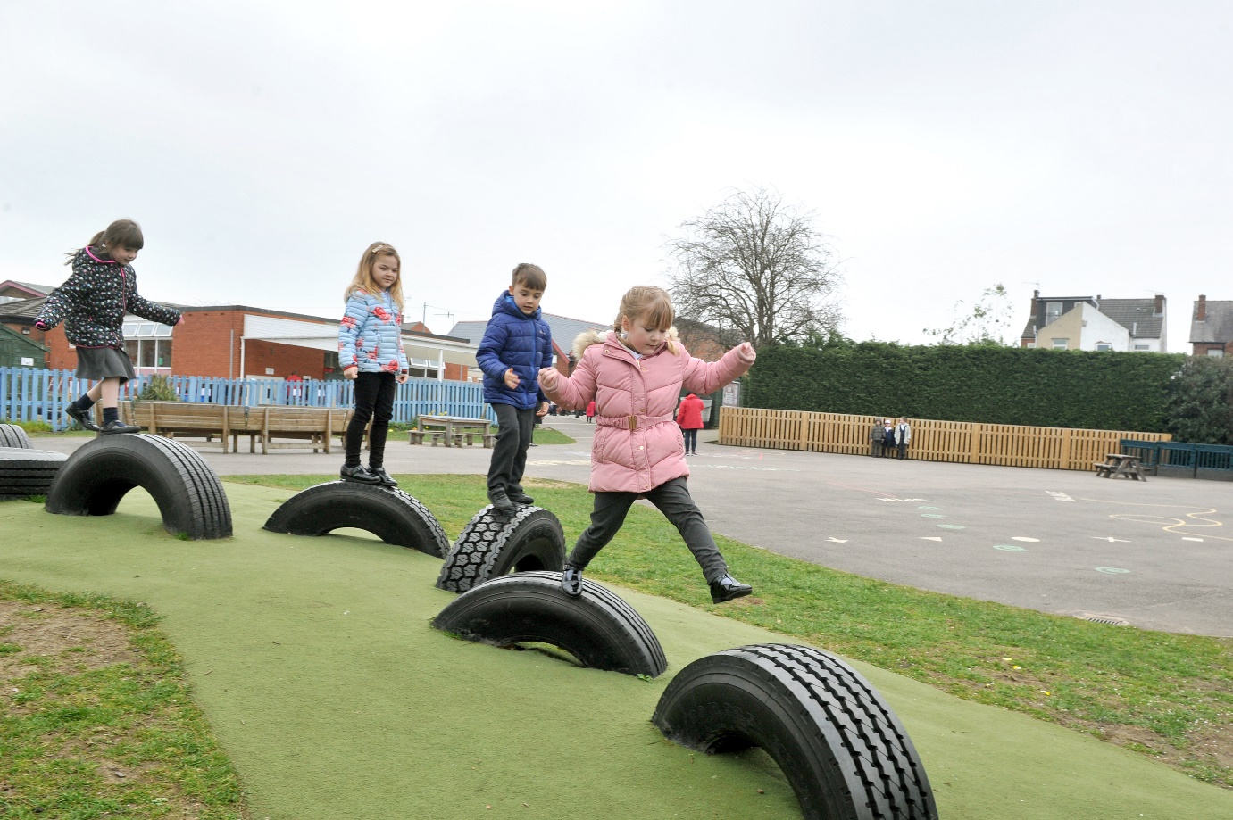
Thank You for coming!!
We look forward to working with you and your children in September.

